Slide 1
Neuro-bubbles Data
June 12th, 2024

Slide 2

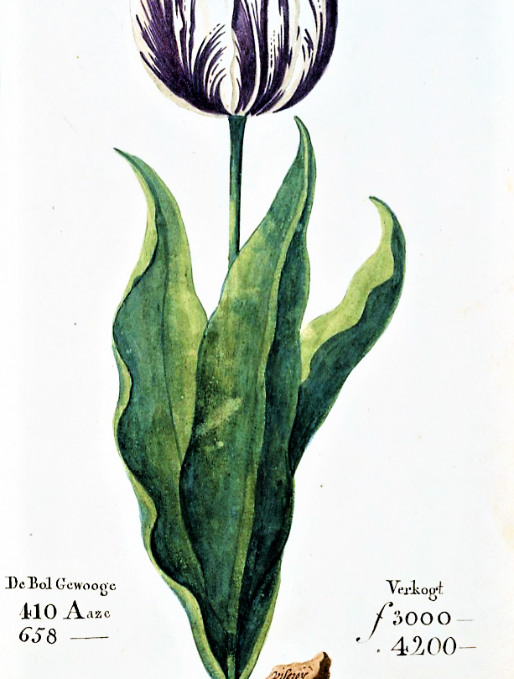
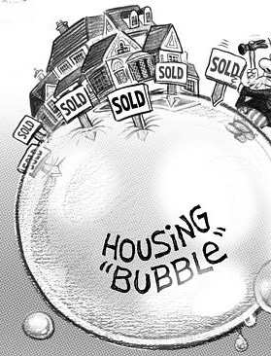
Financial Bubbles

Slide 3
What is a financial bubble
A bubble is an economic cycle that is characterized by the rapid escalation of market value, particularly in the price of assets. This fast inflation is followed by a quick decrease in value, or a contraction, that is sometimes referred to as a "crash" or a "bubble burst."

Slide 4
Bubble Literature Experimental Finance
Irrational exuberance and neural crash warning signals during endogenous experimental market bubbles (2014 Smith, Camerer, et al.)
Price bubbles, gender, and expectations in experimental asset markets (2017 Holt, Porizo, Song)
Gazing through the bubble: an experimental investigation into financial risk-taking using eye-tracking (2023 Toma, et al.)
A hybrid neuro-experimental decision support system to classify overconfidence and performance in a simulated bubble using a passive BCI (2023 Toma)

Slide 5
Research Goals
Extend the Experimental Finance Literature by integrating biometric data (EDA) into an experimental asset pricing market.

Slide 6
What is EDA
Electrodermal Activity (EDA): Electrical charges measured on the skin that arise when the skin receives innervating signals from the brain
Example: If you experience stress or an increase of cognitive load, you may not consciously notice changes but likely the brain has sent a signal that could be detected.
How is it measured
With an Empatica, think apple watch on steroids
Types of Data
Skin Conductance: Tonic vs Phasic
Tonic: Average activity over time
Phasic: Spike activity

Slide 7
Research Goals
Extend the Experimental Finance Literature by integrating biometric data (EDA) into an experimental asset pricing market.
Investigate if and how physiological responses can forecast asset bubble crashes
Classify trader behavior using EDA data
Smart vs Dumb Money
Investigate the relationship between risk-varying premia and asset bubble formation

Slide 8
Experimental Design

Slide 9
Experimental Design
Asset Bubble Formation
Asset Price Forecasting
Risk Elicitation Task

Slide 10
Asset Bubble Formation

Slide 11
Instructions
https://www.youtube.com/watch?v=232inD_HChc

Slide 12
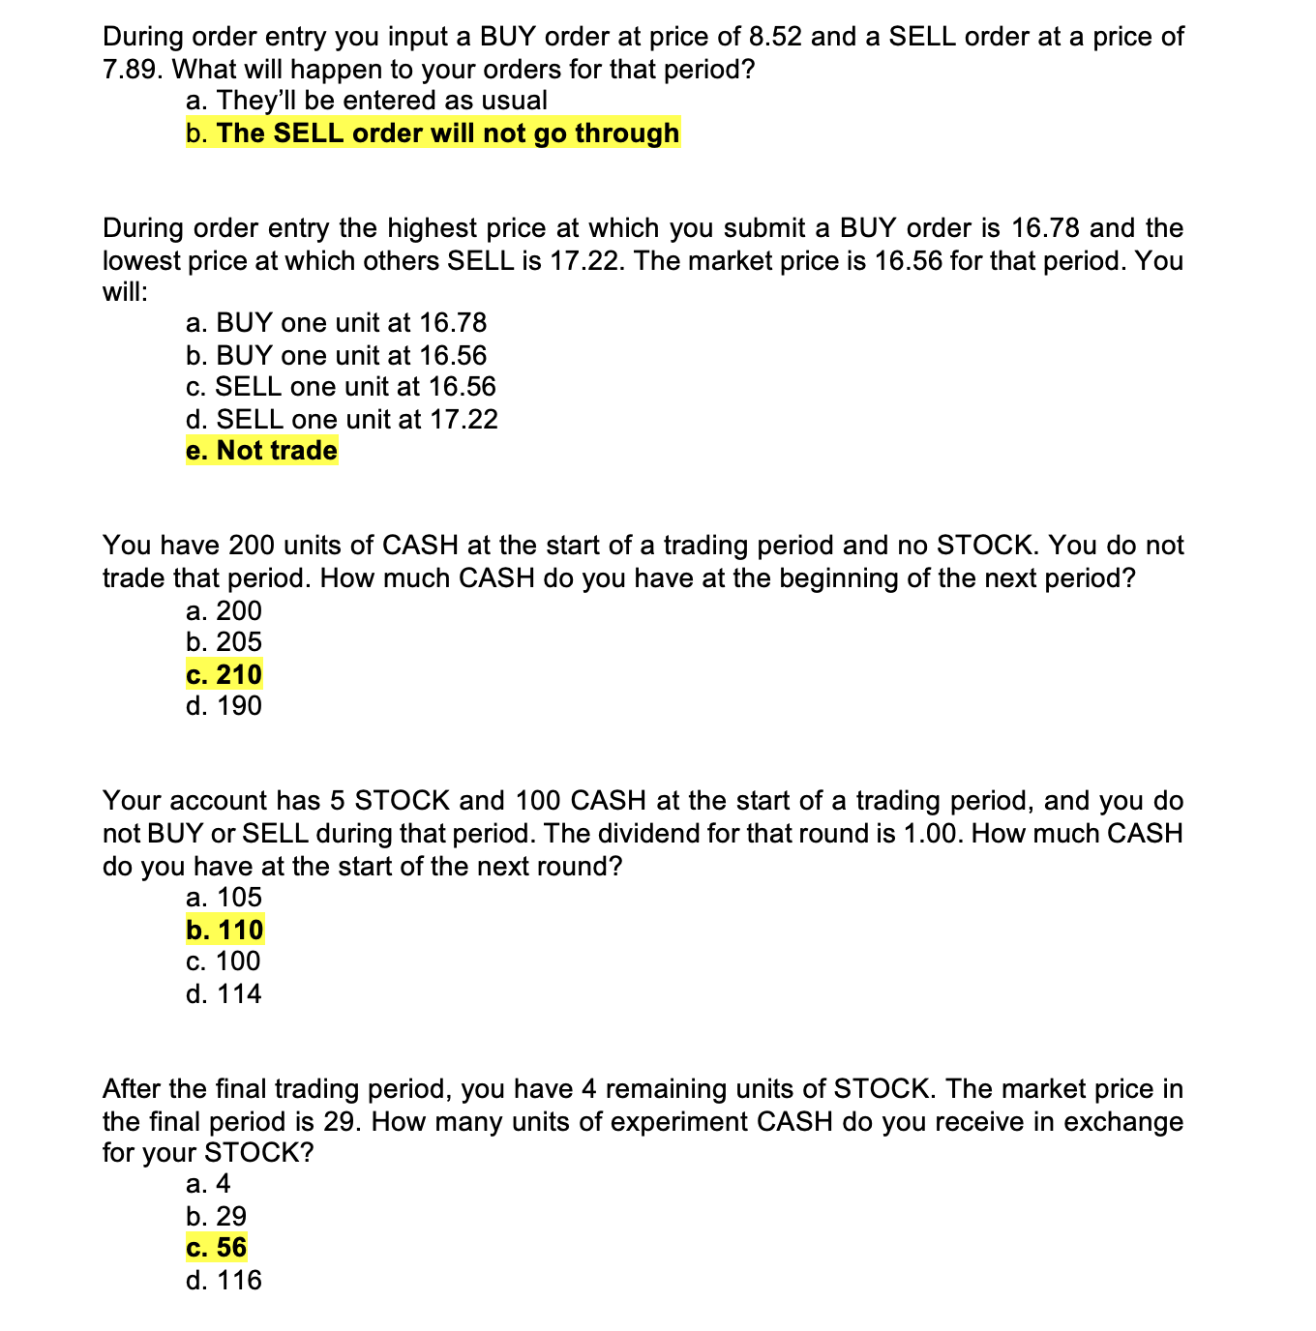
Quiz

Slide 13
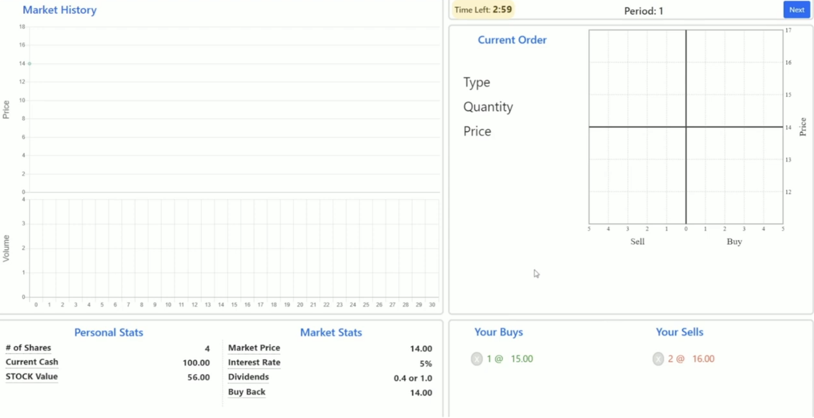
Asset Bubble Formation
Experimental asset market where subjects trade a risky asset in an open-call market for 30 periods (Smith et al., 2014).
Market Structure
33 Trading Periods (3 practice)
15-25 simultaneous participants
5 In-Lab
10-20 online participants

Slide 14
Asset Bubble Formation
Asset Endowment
140 units of CASH
4 units of Risky Asset
Interest/Dividend
CASH: 5% every trading period
Risky Asset: Dividends of either 0.4 or 1 with equal probability.

Slide 15
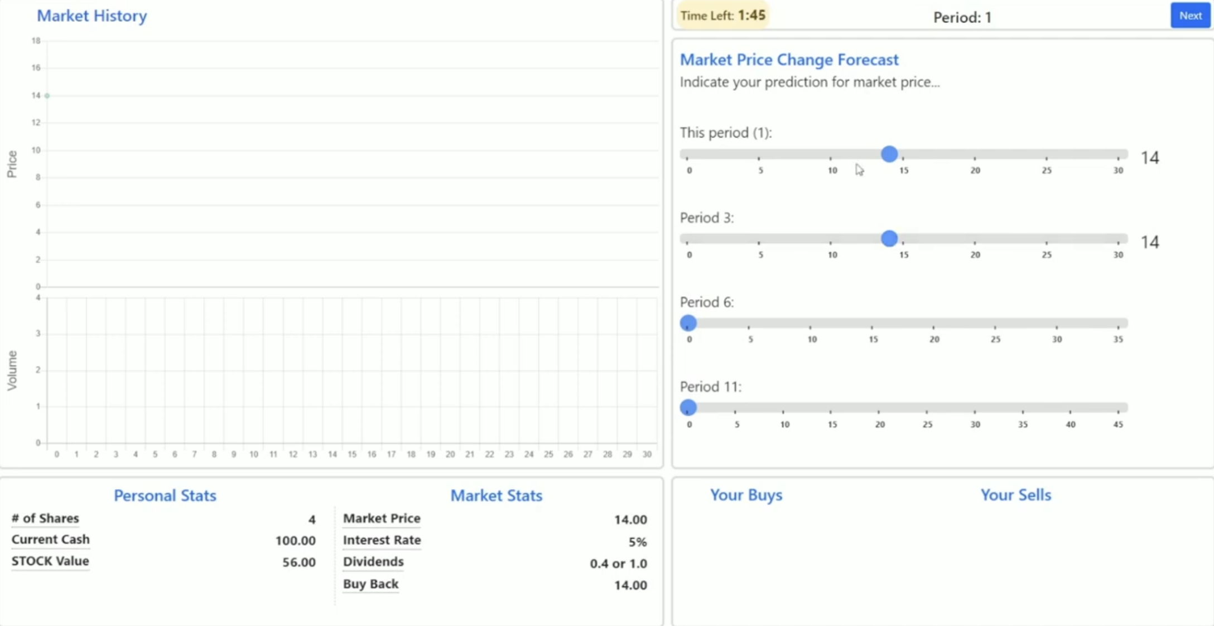
Asset Price Forecasting
A forecast screen where participants submit their expectations with regards to current and future market prices (for 30 seconds)

Slide 16
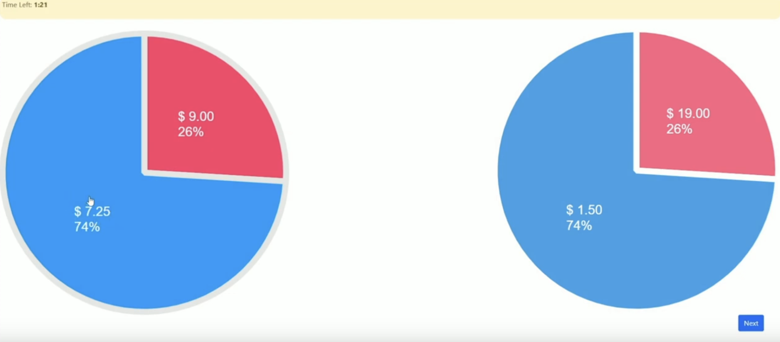
Risk Elicitation Task
A risk-elicitation screen where participants see 4 pairs of lotteries.
It is an application of a Dynamically optimized sequential experiment (DOSE) as outlined in Wang, Filiba and Camerer (2010).

Slide 17
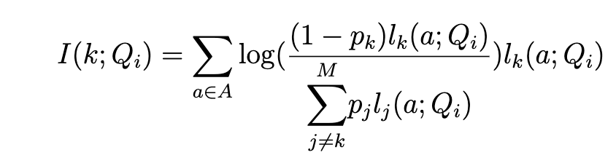
Dynamically Optimal Sequential Experiment (DOSE)
Questions that are asked are customized based on each respondent’s previous answers, to maximize the expected gain in information
Parameters of Interest
r: Risk aversion parameter
μ: The degree of stochasticity choice
Maximize Kullback-Liebler information number
Notes:
A lower value of μ is associated
with choices that are less responsive to differences in valuation
I don’t want to spend too much time analyzing the equation today since we have limited time, but quickly
A is the space of possible responses: in our case the Binary left vs right gamble decision
pk is the prior over the parameter values
lk is the likelihood of a response to a question a, given current model parameters (r, mu)

Slide 18
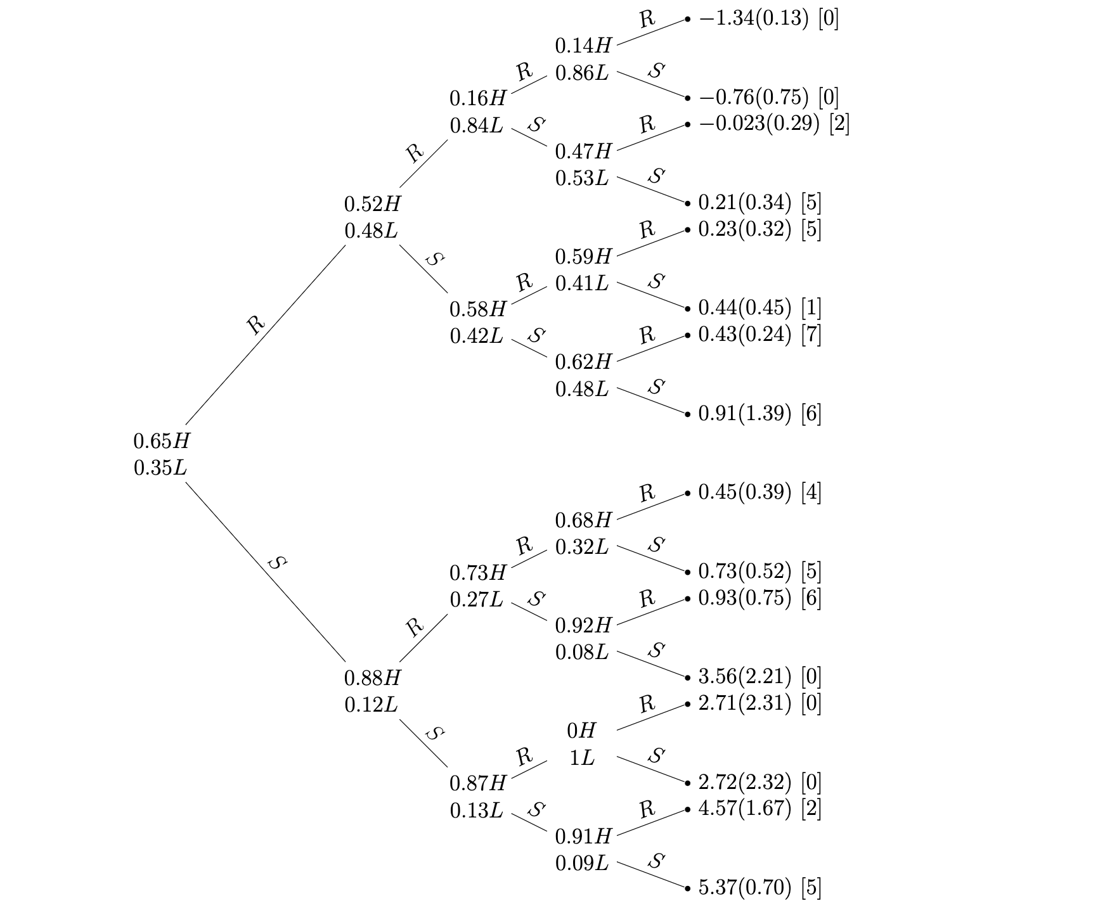
Risk Elicitation Task DOSE
Dynamically Optimized Sequential Experimentation (DOSE) for Estimating Economic Preference Parameters (Wang, Filiba, Camerer 2010)

Slide 19
Initial Data
Looks goodish
But not generating crashes as frequently as desired.

Slide 20
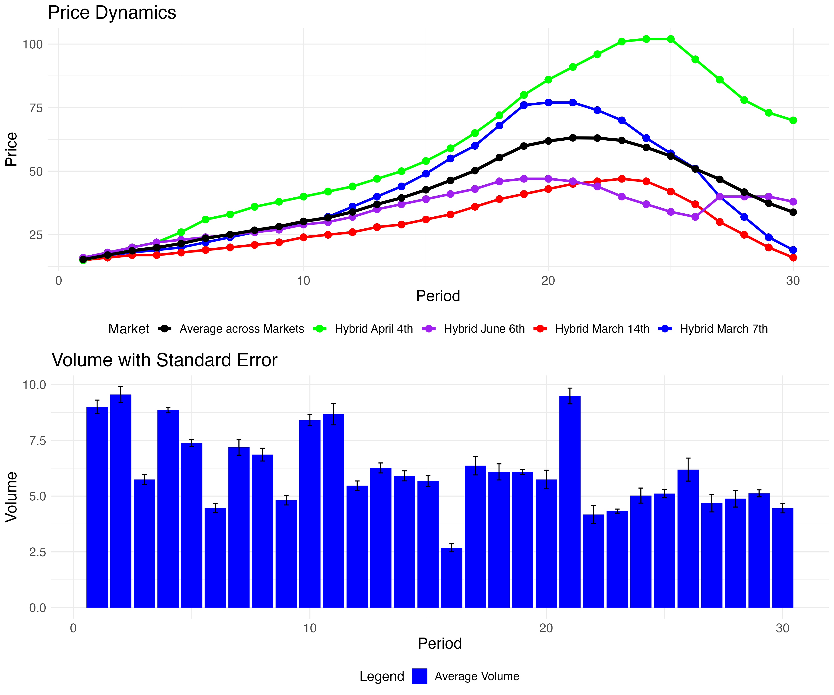
Market Price Dynamics

Slide 21
Market Price Dynamics
Notes:
As you can see, with the black line, the market tens to have a bubble and a slight crash. Issue is it’s not particularly close to fundamental.

Slide 22
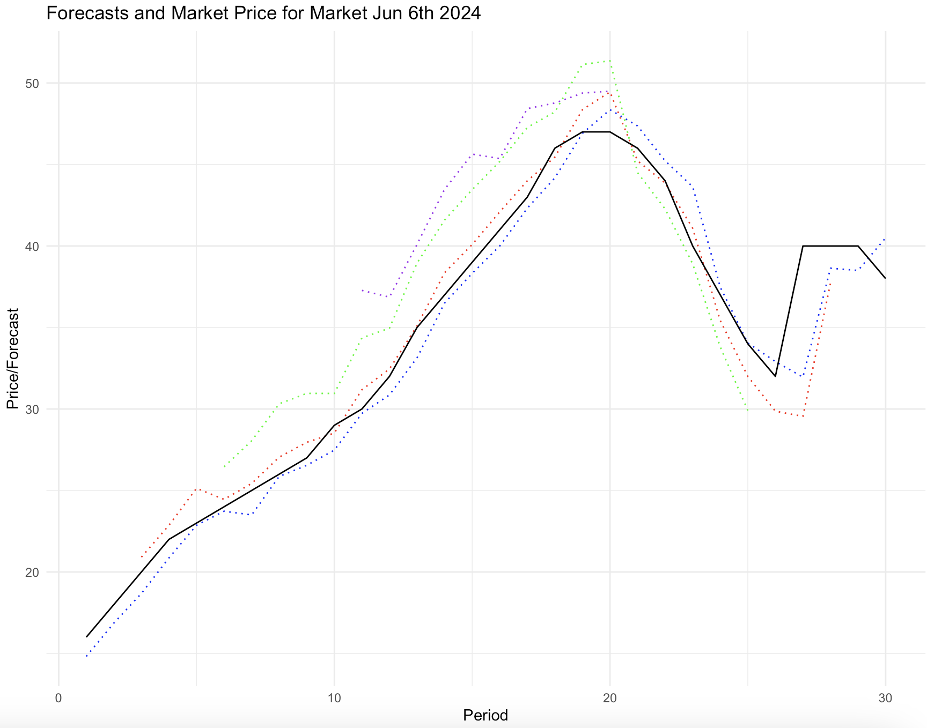
Market price and forecast price

Slide 23
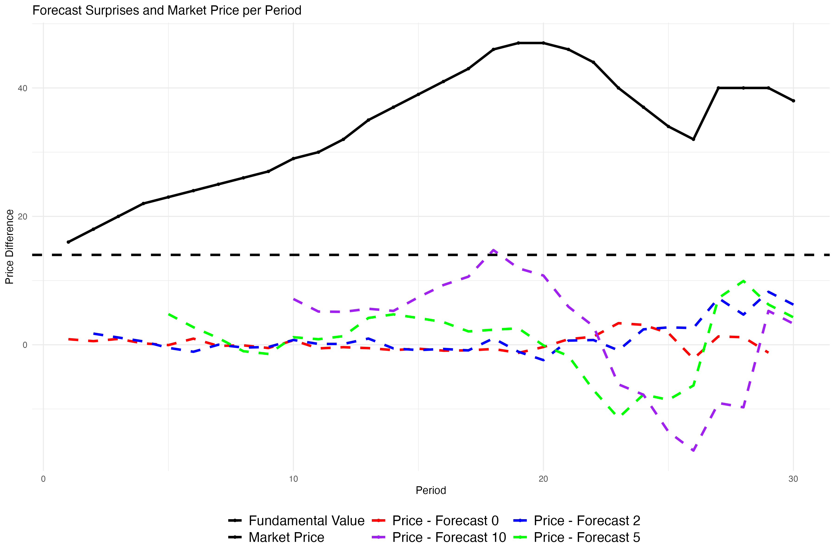
Forecast curve surprise
As you can see

Slide 24
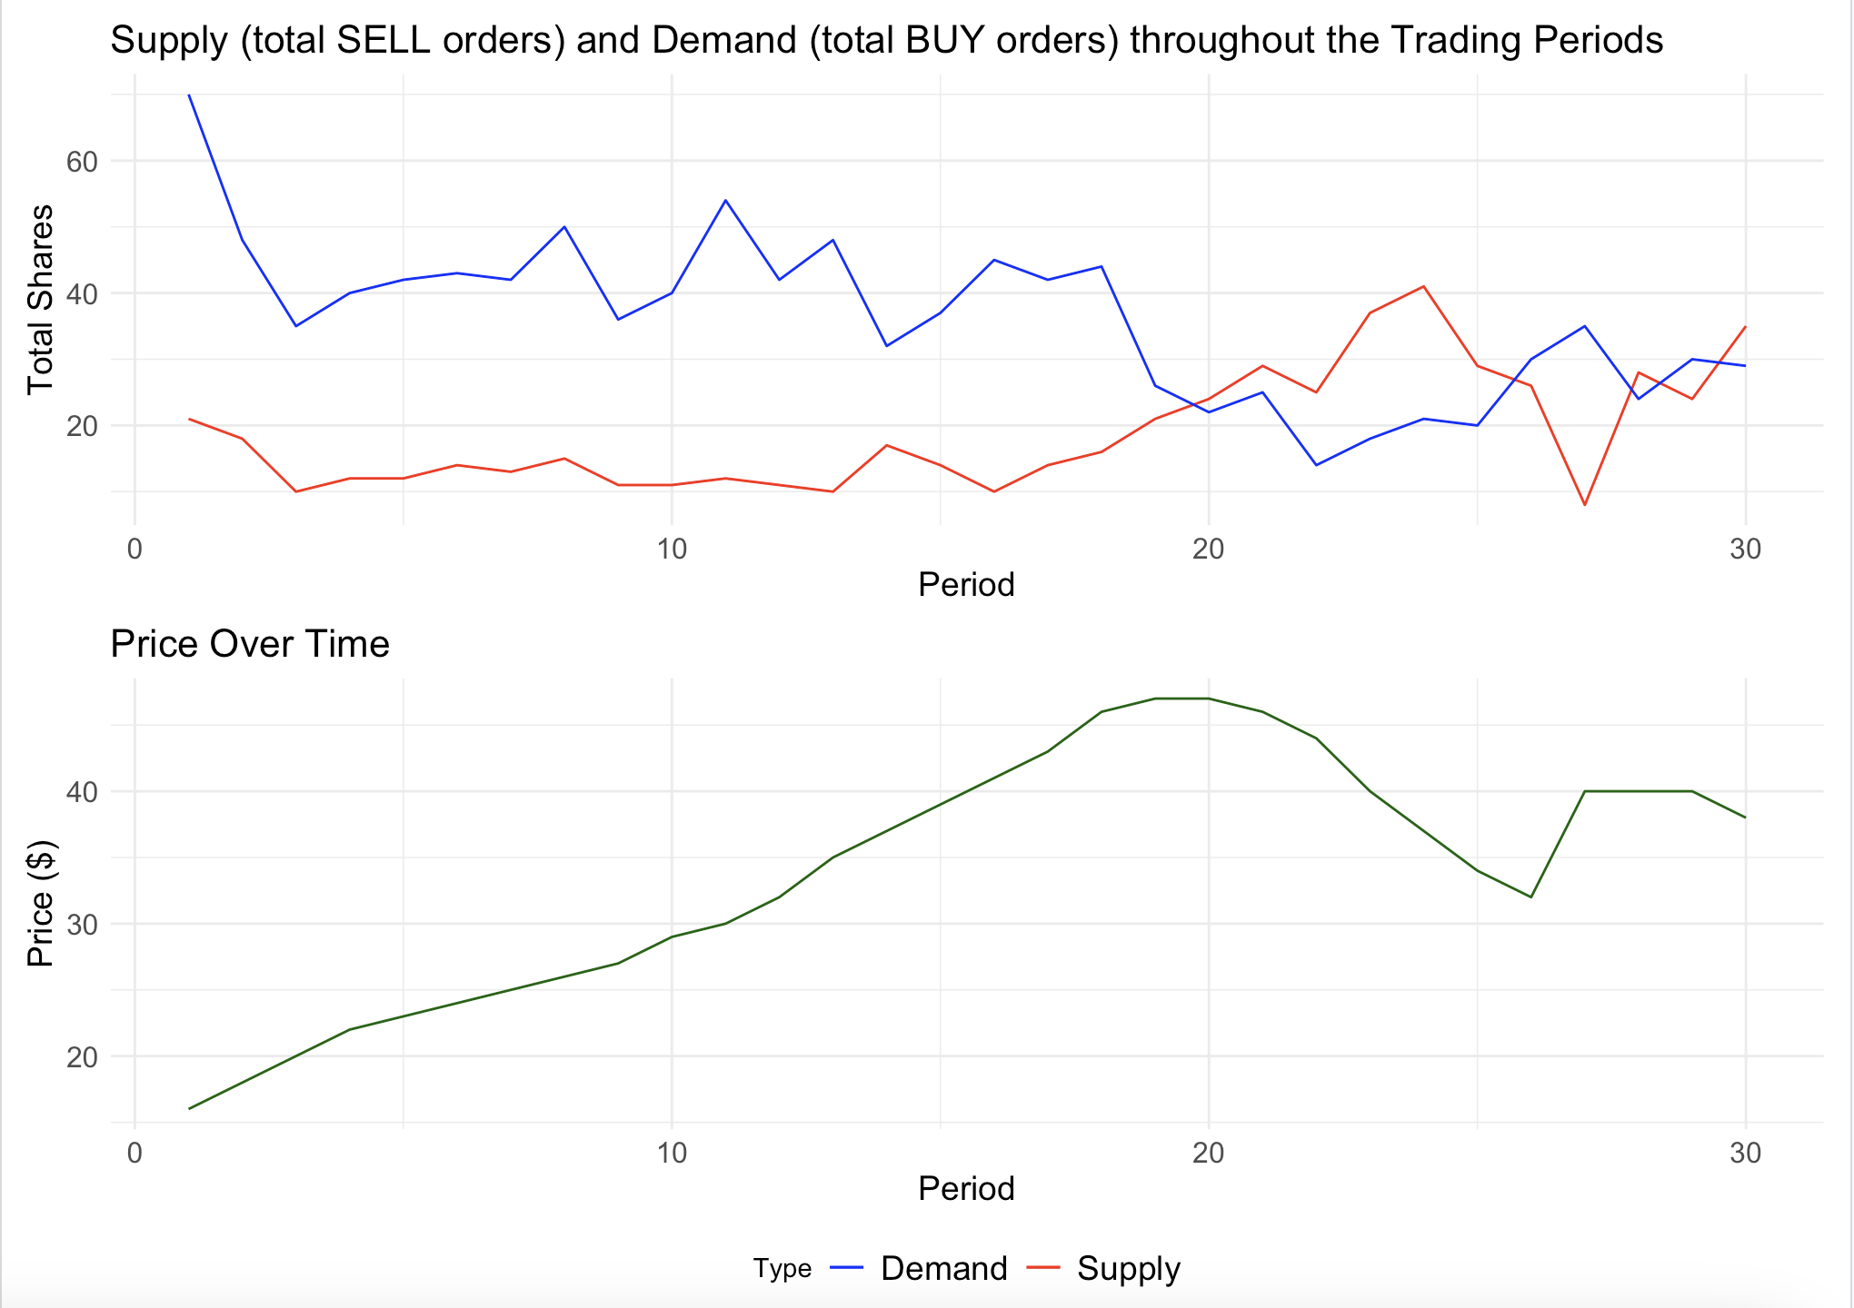
Notes:
Unsurprisingly the crash occurs when there are more sell orders than buy orders, what I want to draw your attention to is tat it seems that the total volume begins to decrease, indicating that the price is being driven by fewer trades

Slide 25
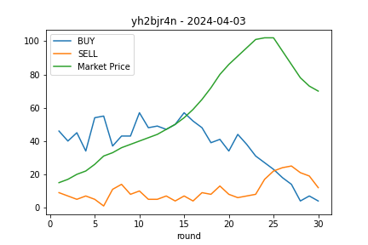
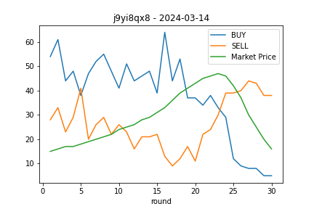
Supply and demand dynamics
June 4th
April 4th
March 14th

Slide 26
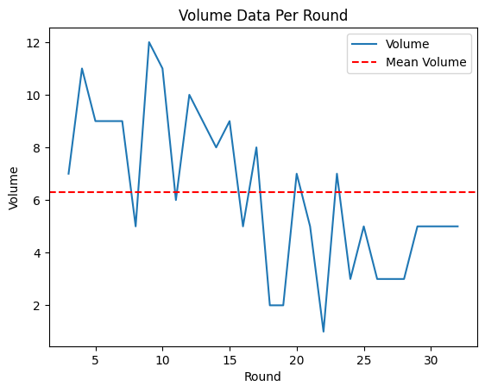
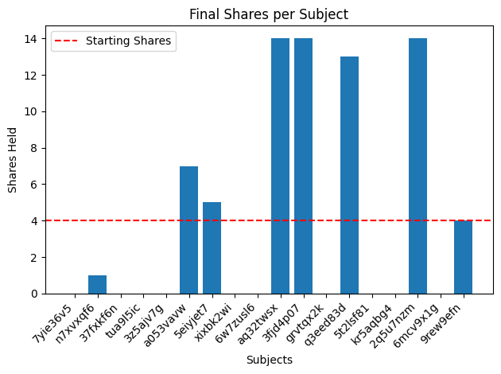
Notes:
Unsurprisingly the crash occurs when there are more sell orders than buy orders, what I want to draw your attention to is tat it seems that the total volume begins to decrease, indicating that the price is being driven by fewer trades. You can also see that the shares per subject are not evenly distributed. This is an example, of a previous market but as you can see at the end a few (as we used to call them in industry) suckers are left holding the bag

Slide 27
Quiz
People are getting the last question wrong
Solutions:
Paying for correct answers
Kicking individuals out that don’t answer correctly with 3 tries

Slide 28
Data Analysis

Slide 29
Risk Elicitation Data Analysis

Slide 30
Results – risk taking parameter R averaged across participants

Slide 31
Results – risk taking parameter Mu averaged across participants
Notes:
Seems like nothing

Slide 32
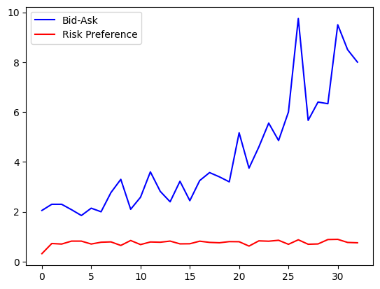
Results – Spread vs Risk Elicitation
Counter to classical expectation Are people making real lottery choices?
Notes:
Seems like nothing

Slide 33
EDA Analysis

Slide 34
Market price and Avg EDA

Slide 35
Variables of Interest
Machine Learning

Slide 36
Variable of Interest
Classification/Clustering
Crash Probability
How likely a crash will begin at the current trading round
Individual Differences
Good vs Bad Traders
Traders that buy as the bubble is crashing vs traders that only sell
Regression
Market price predictions
Can we predict market price with available data

Slide 37
ML Methods
XgBoost/Decision Tree
More Interpretable
Potential overfitting issues
SVM
Good for high dimensional/low sample data
Better for Panel data?

Slide 38
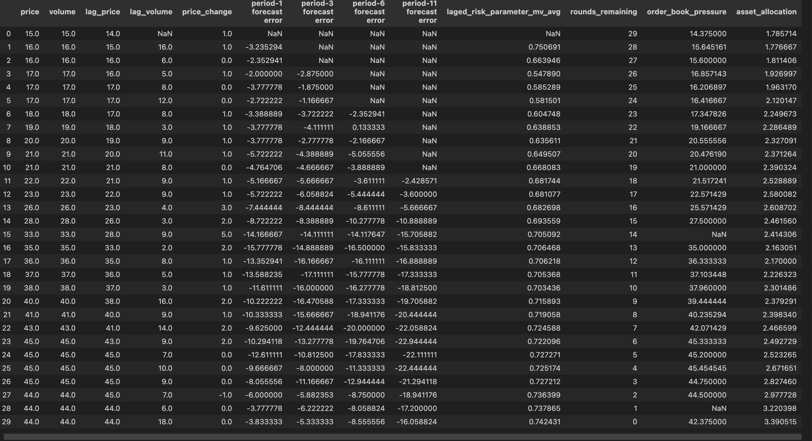
How should I do data imputation?

Slide 40
Ideas
Artificial Crash/ Fed and Interest Rates

Slide 41
Appendix

Slide 42
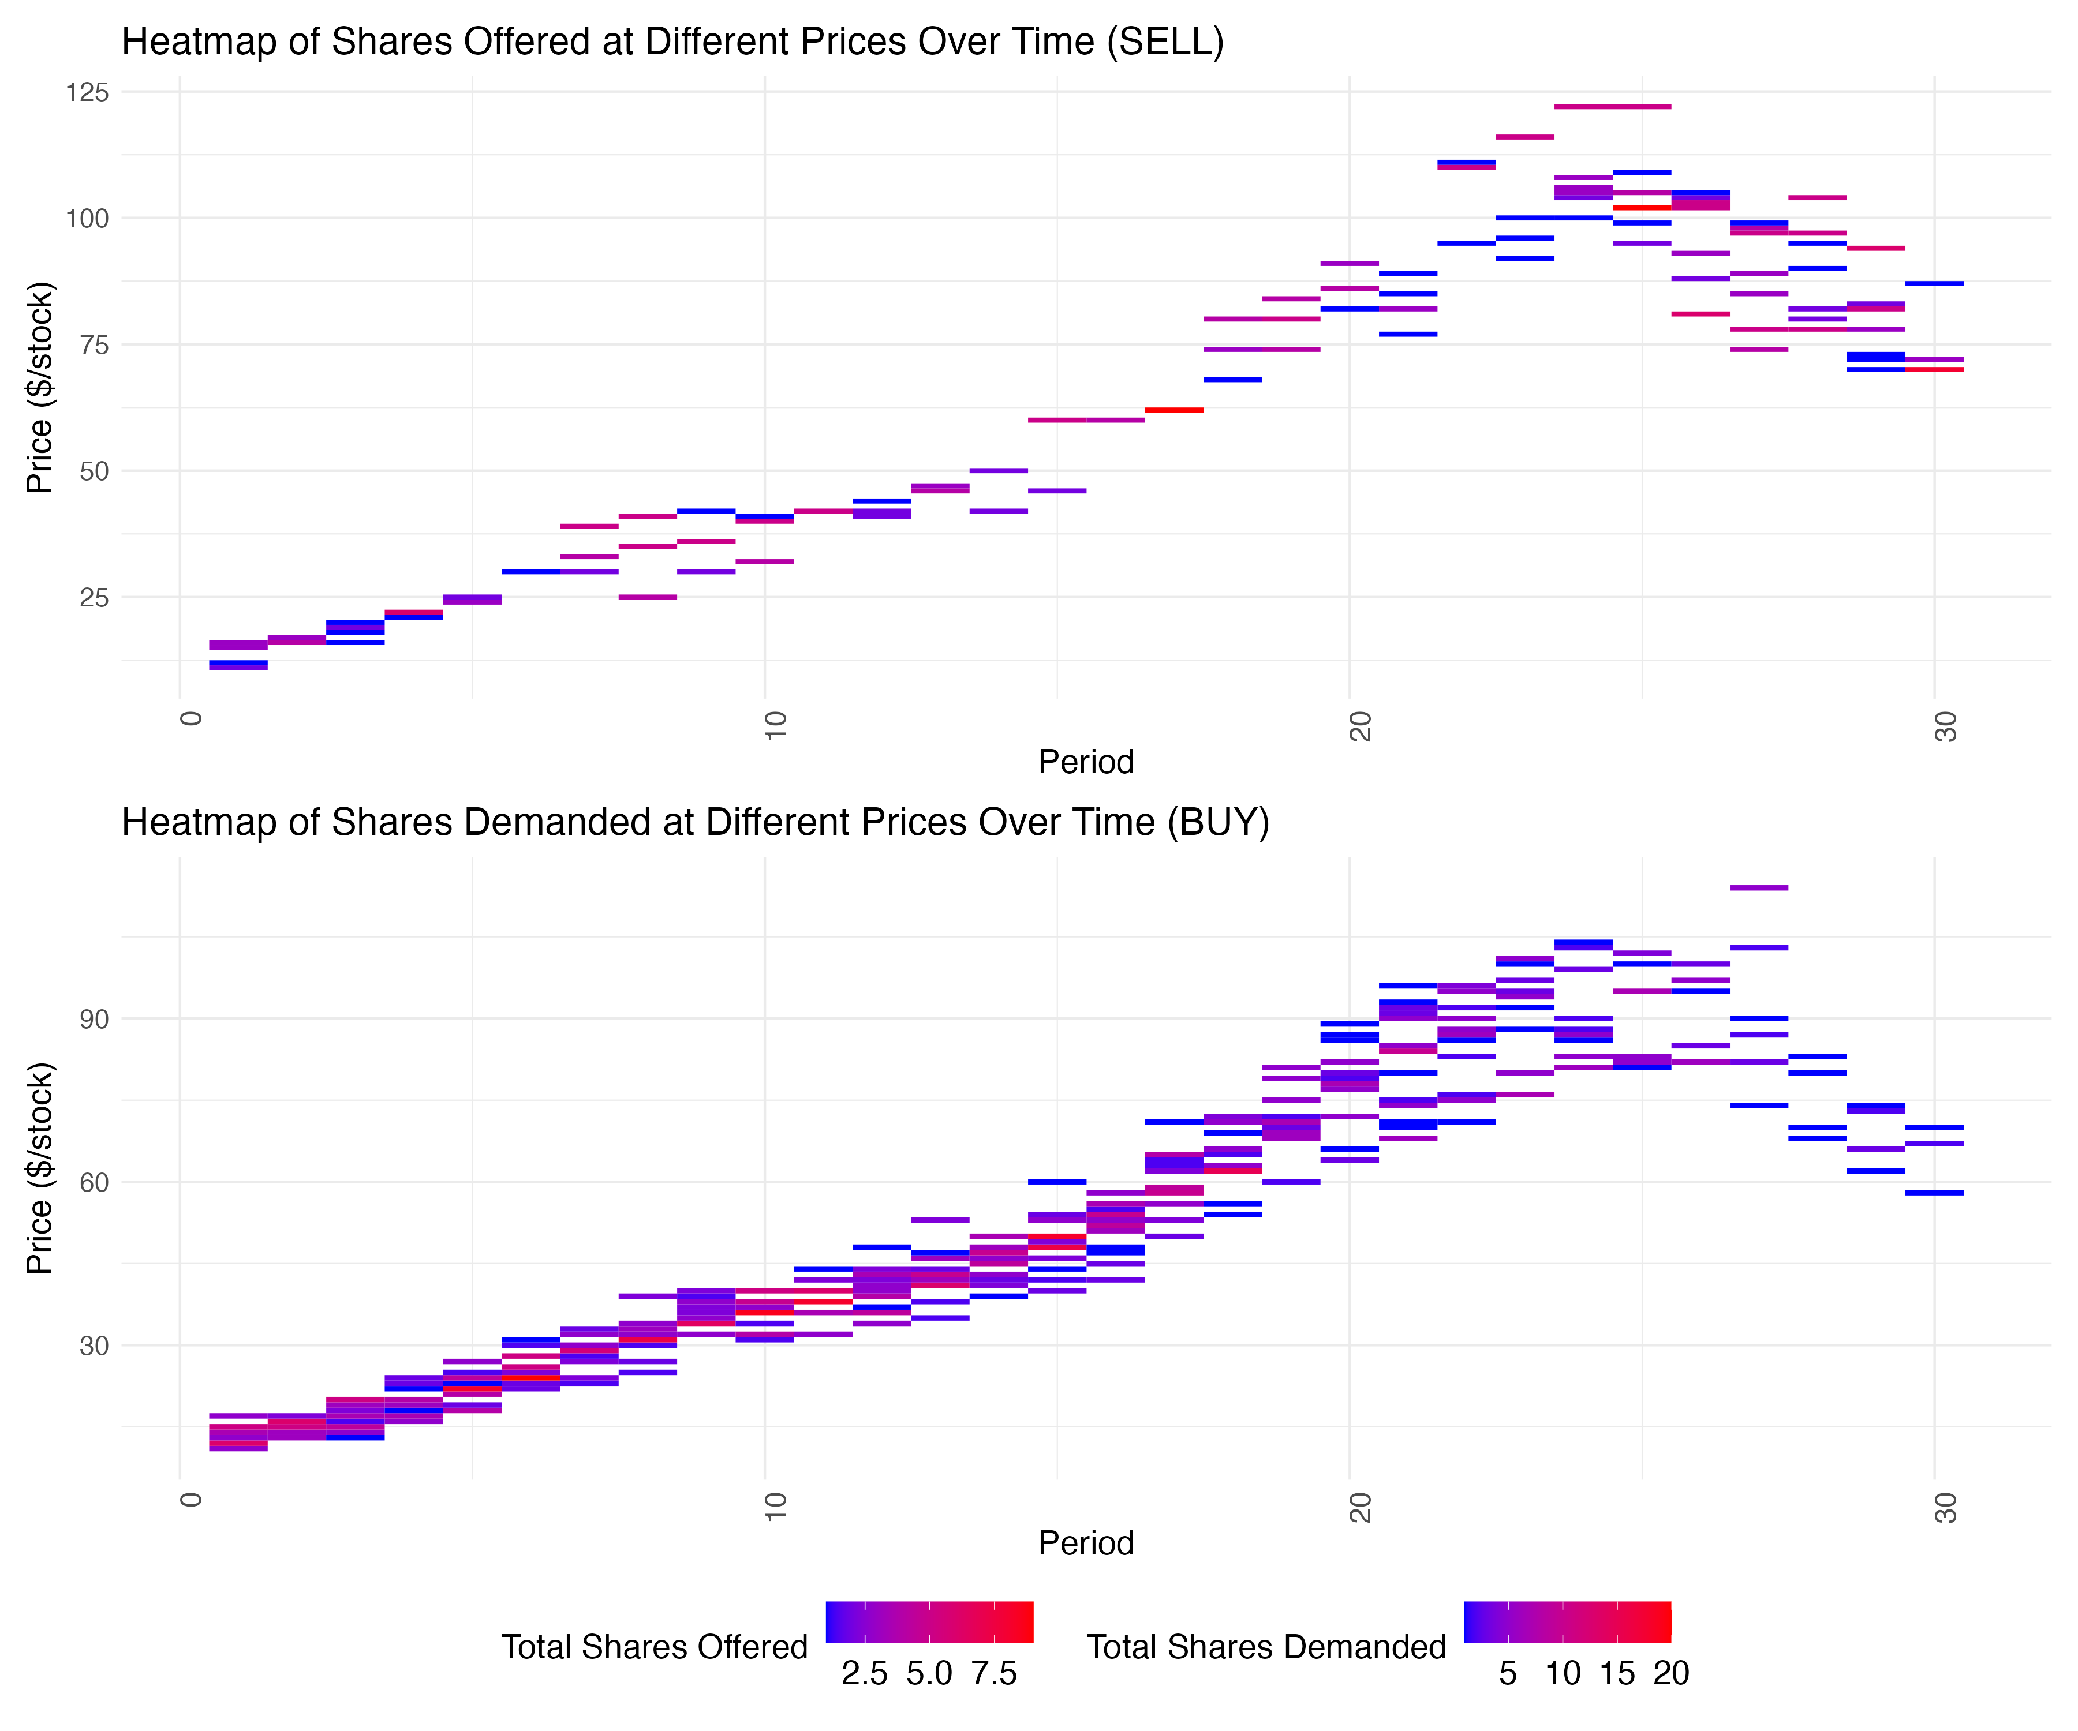
Hybrid 4 April 2024

Slide 43
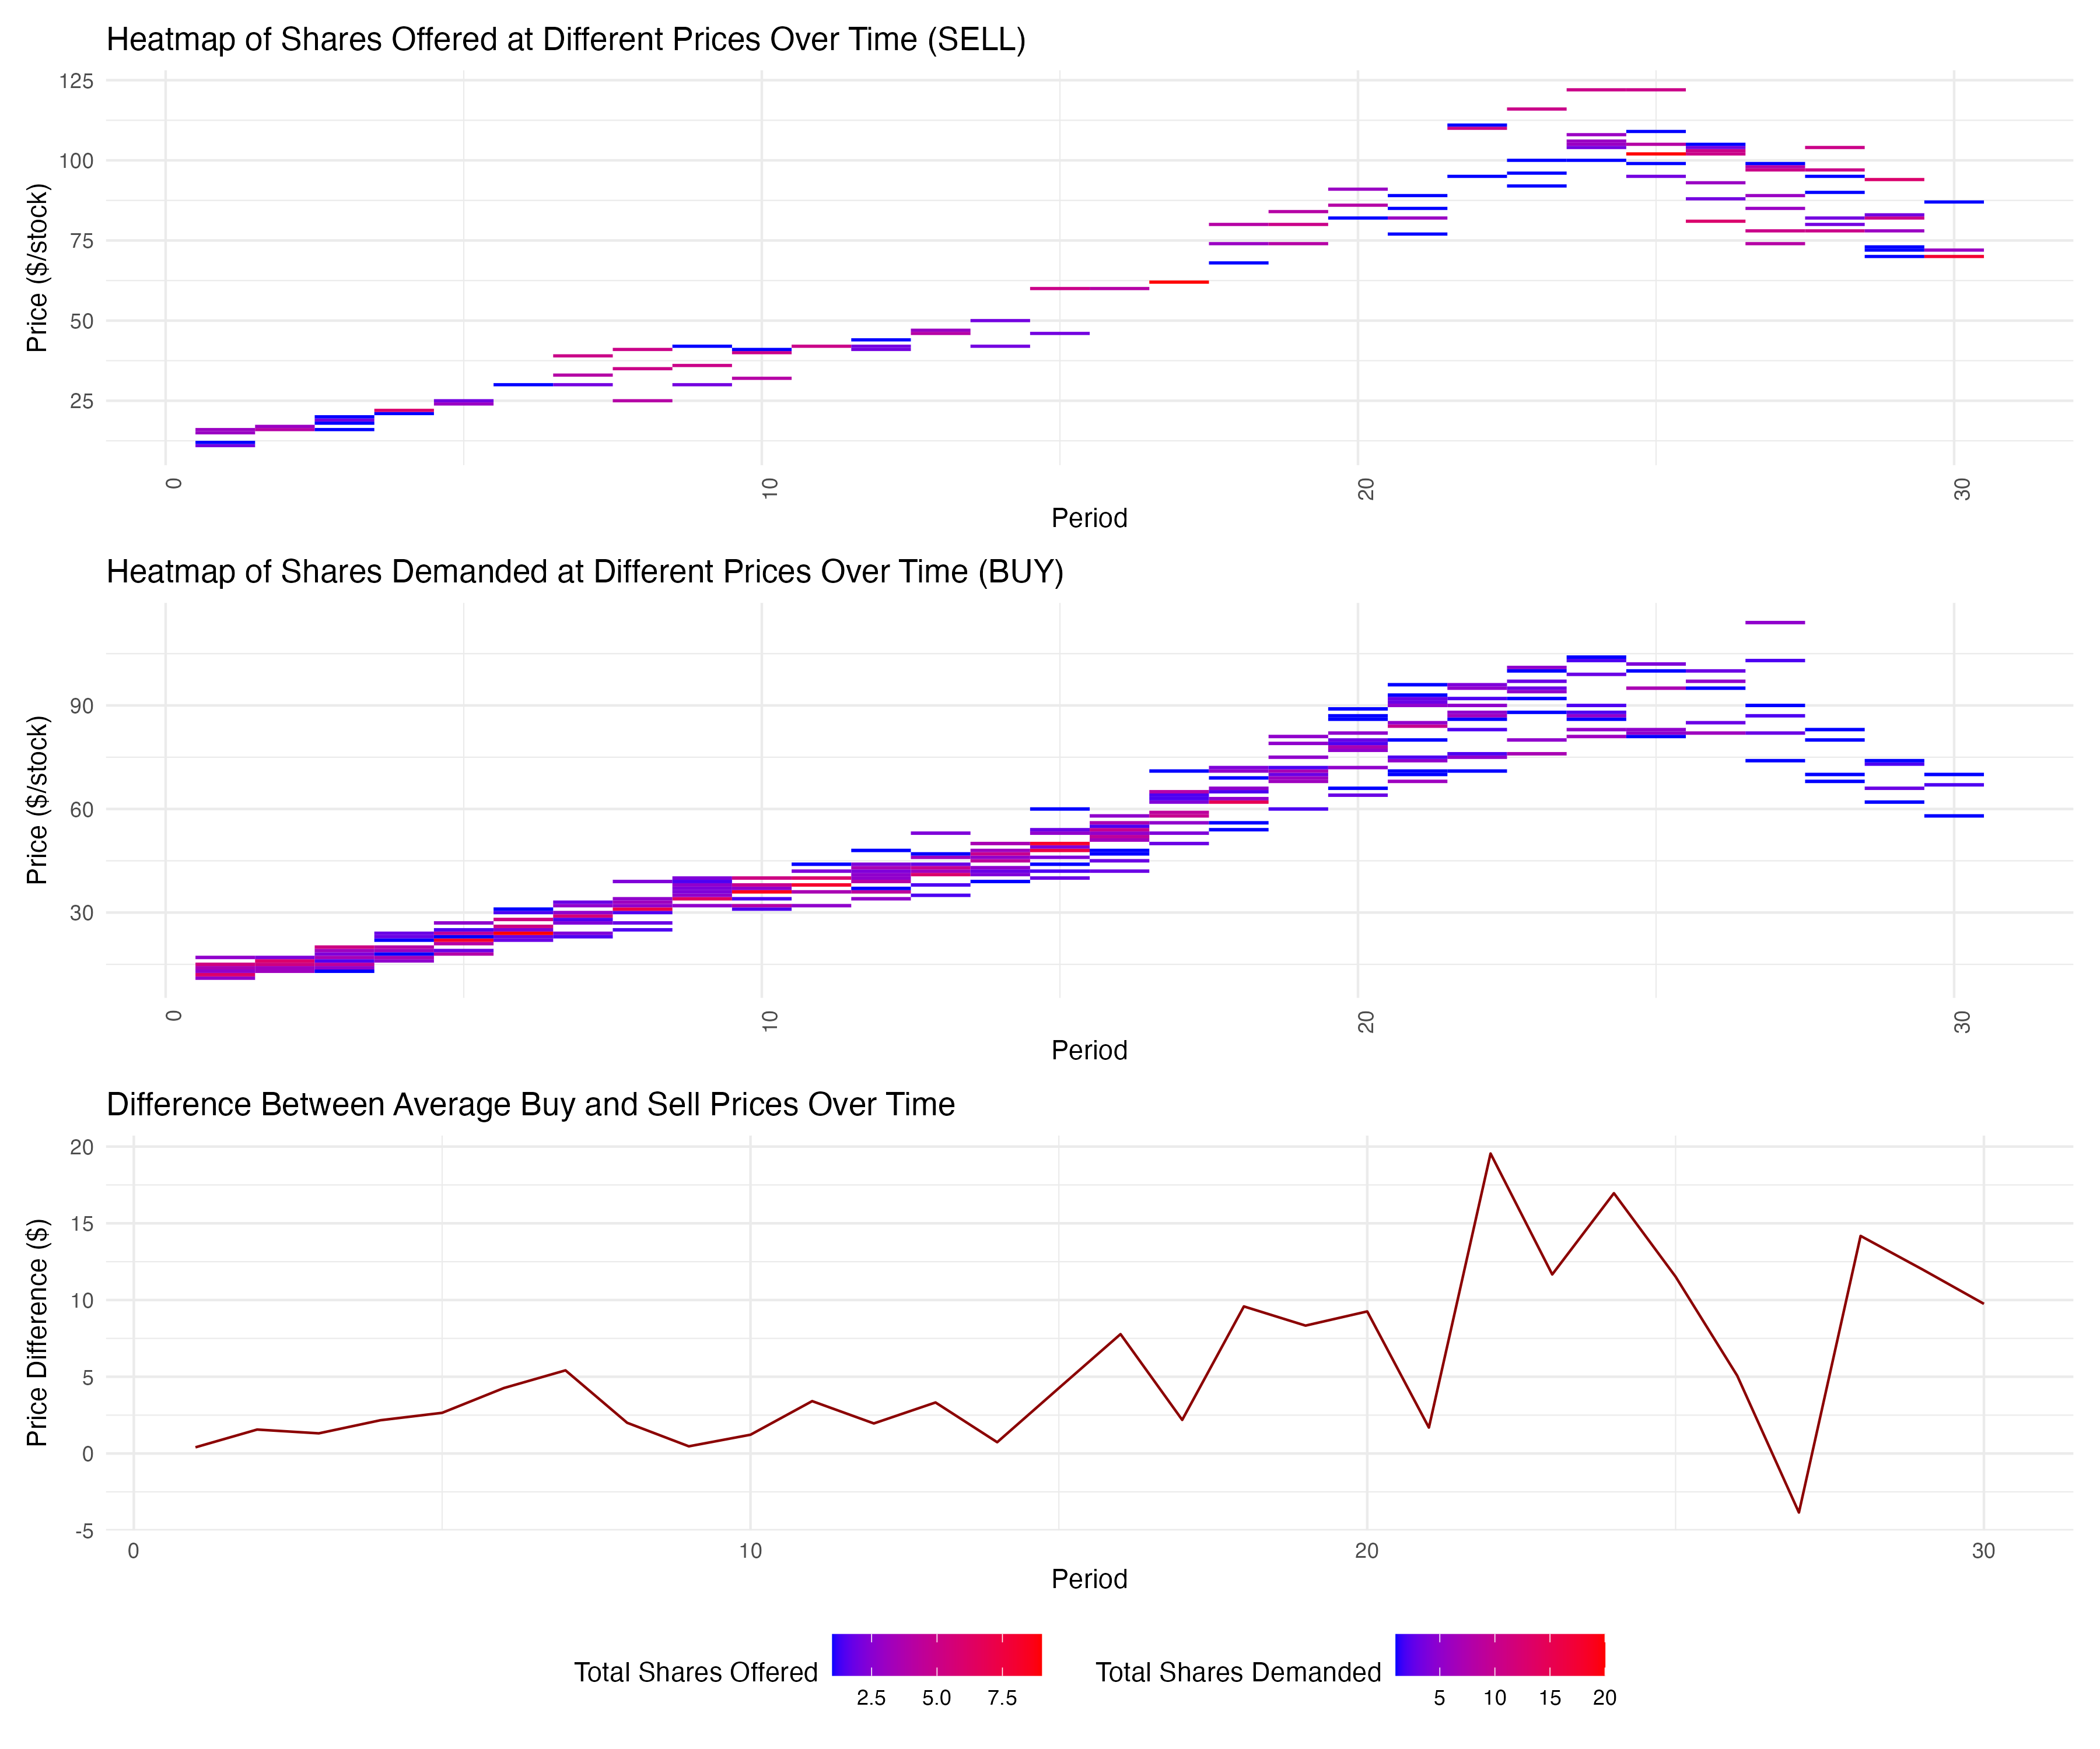
Hybrid 4 April 2024

Slide 44
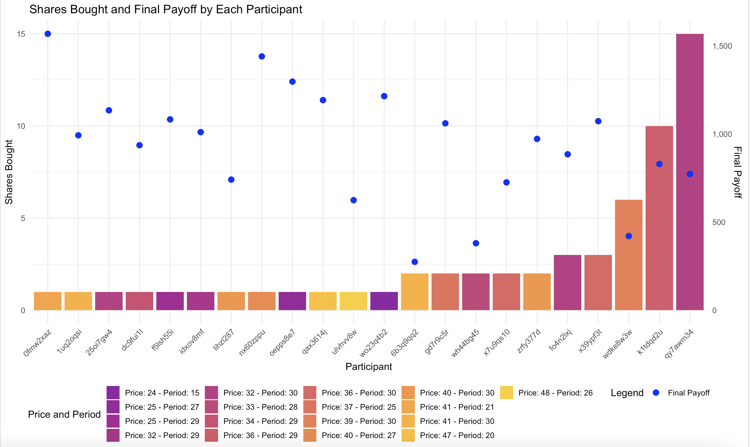

Slide 45
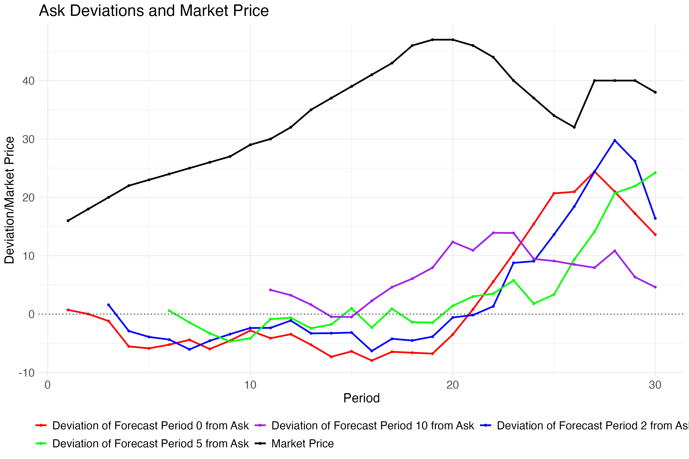
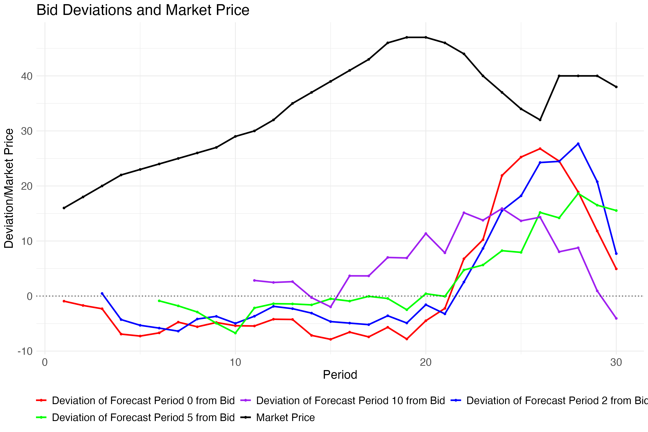
Bid and Ask deviations

Slide 46
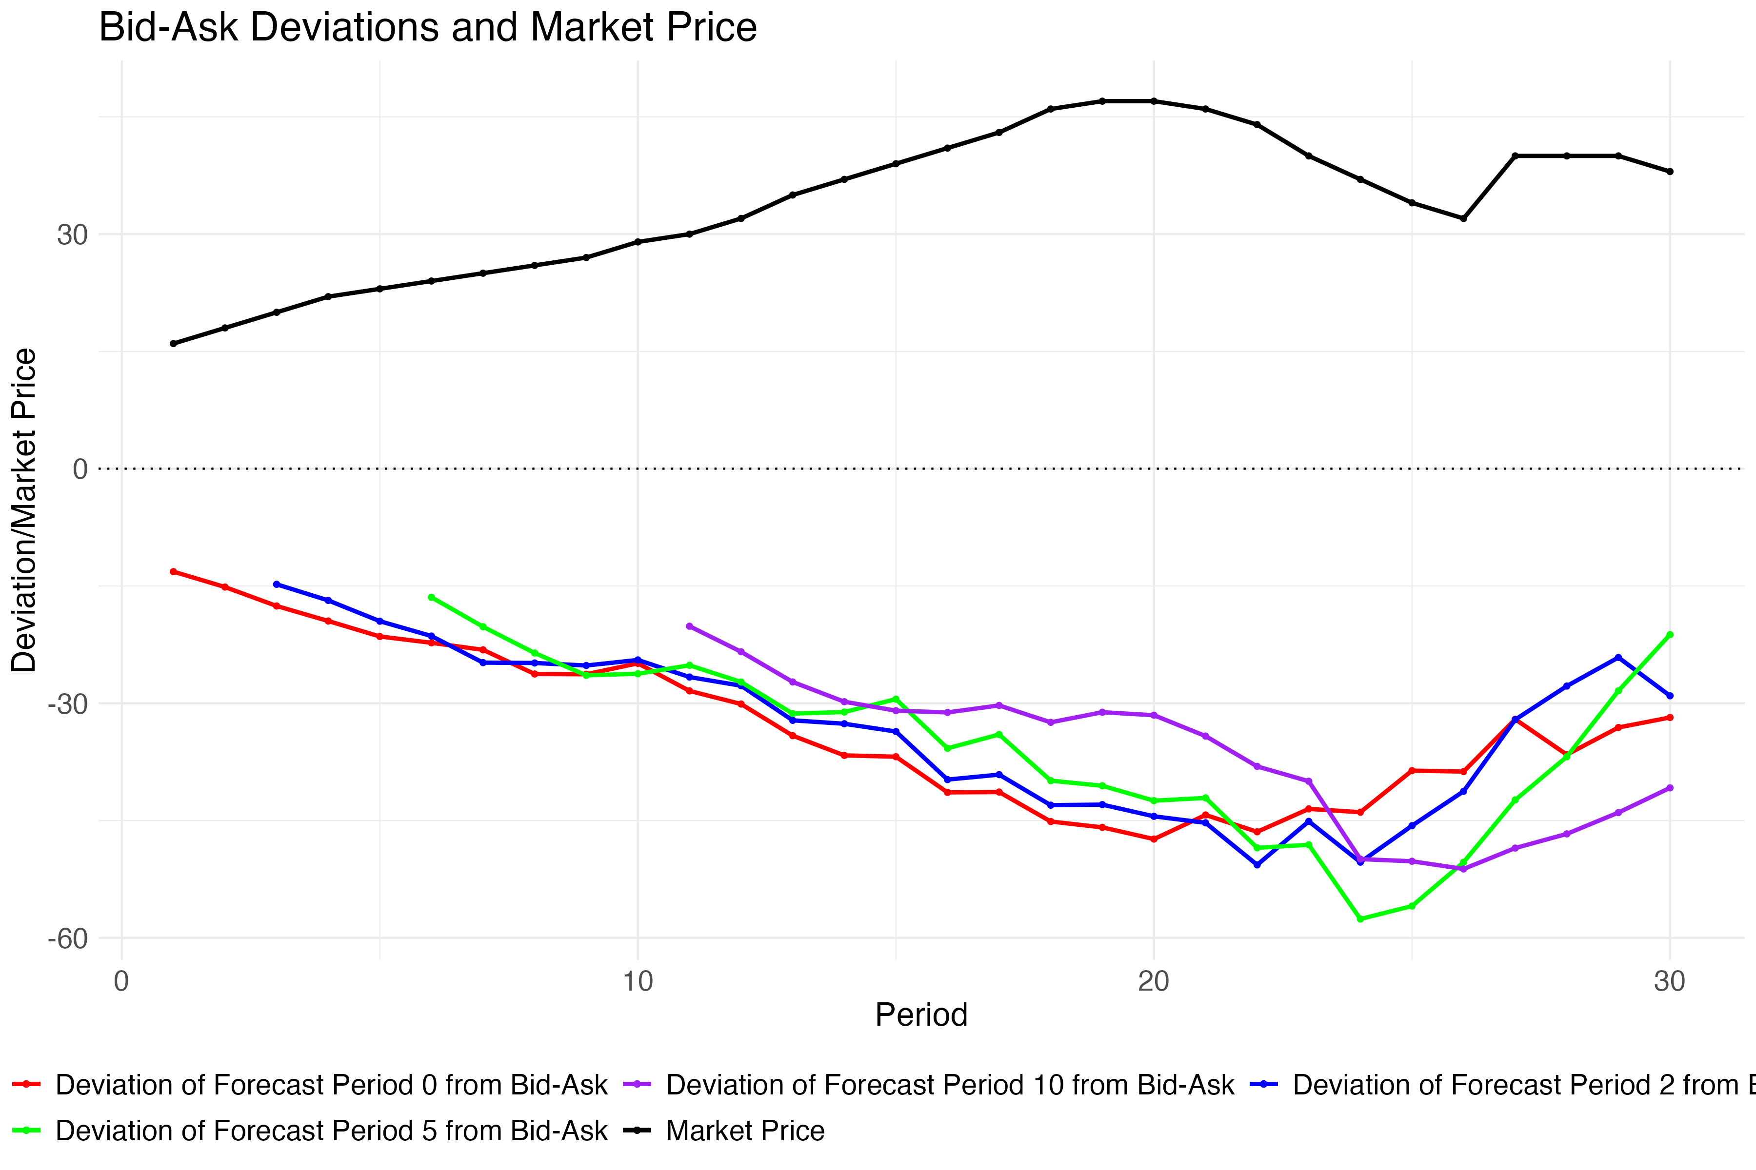
Bid and Ask deviations

